Slide 1
Notes:
First Slide

Slide 2
About DevelopIntelligence
Company
Highly-customized, role-based learning solutions
Managed Learning Solutions include training design and development, and learning program delivery and management
Technical learning offerings in software development, open source technologies, and technology leadership development
Software development and engineering organizations benefit most from our Managed Learning Solutions
Background
Founded in 2003
Headquartered in Boulder, Colorado
Founder and CEO, Kelby Zorgdrager, has 20 years’ experience in Technical Learning and Development industry
More than 50,000 developers trained in 30 countries since 2003
Managed and delivered learning solutions to more than 4,000 developers globally in 2017
Notes:
Second Slide
Share a bit about DevelopIntelligence
- As developers you want to learn!
- As a corporation you want your developers to align their learning with your business goals.
- That’s where we come in… Keeping developers current, bringing others up-to-speed … all aimed at moving your business forward!
- We started in 2003 by a Sun Microsystems developer that wanted to help developers level-up and see business better leverage IT

Slide 3




























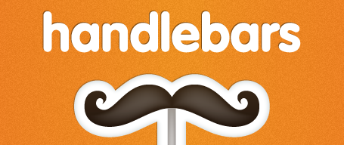



















Course Offerings
Overview
Over 200 different course offerings available in Java development, Front-end, Big Data, DevOps, Mobile application development, and more.
Courses delivered by an expert practitioner – our instructors are passionate about doing and teaching.
Consistently achieve 98% or higher satisfaction rating from students.
Technologies we cover
Notes:
Third Slide
Areas of DevelopIntelligence expertise
DevOps: Chef / Puppet
BigData: Hadoop / Cassandra / Spark
Machine Learning
Front-end: React / Angular
Cloud: AWS / Azure
- Started as a Java shop -> keep growing -> haven’t looked back
- Our specialty is hiring expert practitioners that can come alongside teams and teach them how to move forward

Slide 4
Notes:
Last Slide

